Slide 1
Build a basic Connector
Build a Connector

Slide 2

Build a Connector
Connector Registration and Configuration
Developing a Configuration Page
Security and Storage requirements
Integrating with External Services
Demo

Slide 3
Connector Registration and Configuration
Connector Configuration page
Specified in Connector Developer Dashboard
Hosted by developer
Must be hosted at a domain listed on dashboard
Loaded in IFRAME in application
Connector Instances
Connector can be configured for multiple Inboxes/Channels
A connector can have multiple instances for same inbox/channel
Store configuration data for each instance

Slide 4
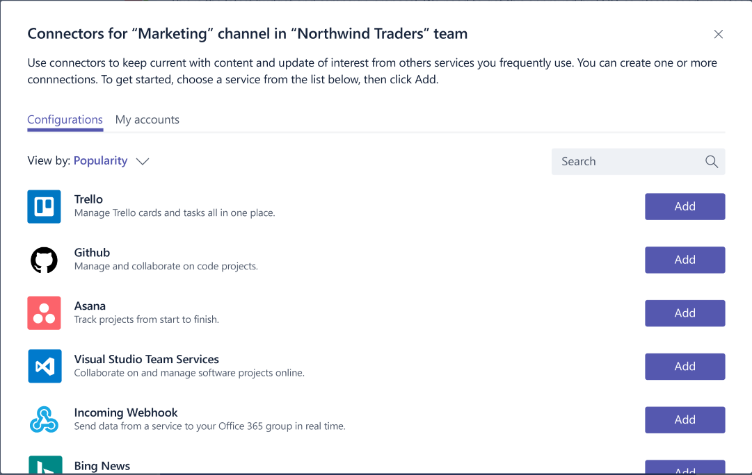
Inline Connector Experience (Preview)
Integrating the configuration experience
The user clicks on your connector to begin the configuration process.
Teams will load your configuration experience in line.
The user interacts with your web experience to complete the configuration.
The user presses "Save", which triggers a callback in your code.
Your code will process the save event by retrieving the webhook settings Your code should then store the webhook to post events later.

Slide 5
Developing a Configuration page
JavaScript
Include Teams JavaScript Library
Save button is disabled by default
Call microsoftTeams.settings.setValidityState() after validation
Register an OnSaveHandler
Store configuration data
Call microsoftTeams.settings.setSettings() to persist Connector instance information
Call notifySuccess()/ notifyFailure() to close dialog
HTML
Do not include chrome
Logo and Description from dashboard are displayed by application
Include form to capture configuration data for external system
Types of events to send connector cards
Time / frequency of reports or digests
Authentication information
Etc.
Notes:
Provide data in well-defined fields. Rendering is handled by host application

Slide 6
Configuration page
Connectors configuration settings (context) is retrieved by calling microsoftTeams.settings.getSettings()
Parameter | Details
entityId | The entity ID, as set by your code when calling setSettings().
configName | The configuration name, as set by your code when calling setSettings().
contentUrl | The URL of the configuration page, as set by your code when calling setSettings()
webhookUrl | The webhook URL created for this connector. Persist the webhook URL and use it to POST structured JSON to send cards to the channel.
appType | The values returned can be mail, groups or teams corresponding to the Office 365 Mail, Office 365 Groups or Microsoft Teams respectively.
userObjectId | This is the unique id corresponding to the Office 365 user who initiated setup of the connector. It should be secured. This value can be used to associate the user in Office 365 who set up the configuration to the user in your service.

Slide 7
Security Requirements
Use HTTPs
Pages must use HTTPS
Configuration page captures data
Applications will not display insecure HTTP content
Secure the webhook URL
Webhook URL is passed as query parameter
Can be disclosed if Configuration page has links to other websites
Implement a redirect or referrer policy
Once data is stored, redirect browser to page w/o query parameters (HTTP 302)
Add <meta> tag to page header
<meta name="referrer" content="no-referrer">

Slide 8
Storage Requirements
Connecting to Office 365 generates registration data
Webhook URL / App Type
Associate the URL with the App Type (Group/Teams/Mail)
Ensure card is supported by App
Group Name / User ObjectID
Identifies destination of posted data
User Identifier – store securely!
Ensure content is relevant

Slide 9
Interacting with external services
Authenticating
Authentication cannot occur in IFRAME
Connectors JavaScript library facilitates popup and cross-window communication office365.authentication.authenticate({ url: <auth URL>, width: <width>, height: <height>, successCallback: <successCallback>, failureCallback: <failureCallback>})
In <auth URL> signal result and pass data microsoftTeams.authentication.notifySuccess(token) microsoftTeams.authentication.notifyFailure(err)
Redirecting across domains
Ensure pages are specified in validDomains list on dashboard
Redirect to authentication provider from your auth url

Slide 10
Demo Add Connector functionality to existing web site
Notes:
Review various cards in playground: https://messagecardplayground.azurewebsites.net/
Point out that Incoming Webhook requires user to capture and store information. A programmatic way to do that is in following section

Slide 11

Summary

Slide 12
Thank you

